Slide 2
Agenda
Coordinator
Rule Changes

Slide 3
Rule Changes
Rule 1:19
Clarifies the type of electronic devices that are allowed
Rule 2-11-11
Multiple scorers present
Rule 3-3-6
Injured player on the court

Slide 4
Rule Changes
Rule 3-3-7
Time for blood related issues
Rule 3-4-4a
Logo/mascot centered directly above the uniform number
Rule 4-6-1
Basket interference exception

Slide 5
Rule Changes
Rule 4-47-5, 10-2-1g, 10-4-5b
Penalty changes for failure to immediately pass ball to the nearer official when whistle sounds. Warning then T
Rule 4-49, 10-2-1g, 10-4-6f
Faking being fouled (more to come)
Rule 7-1-1
Establishes that a player cannot be assisted from outside boundary line

Slide 6
Rule Changes
Rule 10-1-1, 10-1-2, 10-2-7, 10-5-1
All admin, team, bench T’s that occur during pregame offset – no free throws awarded – and the game will start with a jump ball and the head coach will not lose coaching box

Slide 7
Flopping/Faking Being Fouled
Faking being fouled is defined in Rule 4-49-1 as when a player simulates being fouled or makes theatrical or exaggerated movements when there is no illegal contact. Examples include, but are not limited to, embellishing the impact of incidental contact on block/charge plays or field goal attempts, using a “head bob” to simulate illegal contact and using any tactic to create an opinion of being fouled to gain an advantage.

Slide 8
Flopping/Faking Being Fouled
The new language also establishes a procedure for officials to issue a team warning on the first instance of faking being fouled. The warning is recorded in the scorebook and reported to the head coach. Any additional instances will result in a team technical foul and not a player technical foul, which was previously the case.

Slide 9
Flopping/Faking Example 1 – While Dribbling
Offensive player, A1, is dribbling the ball and fakes being fouled by a defender. This is described in the rules as using a “head bob” to simulate illegal contact.
In this play, the team that is faking being fouled is on offense and there is player control of the ball. (4- 49-1b)

Slide 10
Flopping/Faking Example 1
When does the official blow the whistle and signal for both the first and subsequent infractions?
First infraction: As soon as the official identifies behavior that, in their opinion, rises to the level of faking being fouled the whistle should be blown and the faking signal (New #15) should be displayed.

Slide 11
Flopping/Faking Example 1
Report the warning to the table
Notify the head coach
Go to the point of interruption (POI).
If A1 is in Team A’s frontcourt, Team A will have a throw-in at one of the four designated spots closest to where the faking being fouled occurred.
If A1 is in Team A’s backcourt, the throw-in will be from the spot out of bounds closest to where the faking being fouled occurred. (4-36-2a)

Slide 12
Flopping/Faking Example 1
Subsequent Infraction – A team technical foul is charged to Team A. Team B will shoot two free throws and get the ball for a division line throw-in opposite the scorer’s table. (10-2-1h, 10-2 PENALTY)

Slide 13
Flopping/Faking Example 2 – After shot
Offensive player, A1, after releasing a jump shot, goes to the floor without contact or after incidental contact. This is described in the rules as overtly embellishing the impact of incidental contact on an attempted try for goal. In this play, the team that is faking being fouled is again on offense; however, there is NO team control since the ball was released on a try for goal. (4-49-1a)

Slide 14
Flopping/Faking Example 2
When does the official blow the whistle and signal for both the first and subsequent infractions?
As soon as the official identifies behavior that, in their opinion, rises to the level of faking being fouled the whistle should be blown and the faking signal (New #15) should be displayed.

Slide 15
Flopping/Faking Example 2
First Infraction (Successful Try) – There is NO team control, so when the try is successful, the basket will count, the official will report the warning to the table, notify the head coach and Team B will be awarded the ball on the endline. Team B may move along the endline as after any successful try. (7-5-7)

Slide 16
Flopping/Faking Example 2
First Infraction (Unsuccessful Try) – There is NO team control, and since the try was unsuccessful the ball became dead when the try ended.
There is NO rebounding on this play.
The official will report the warning to the table, notify the head coach and the ball will be awarded based on the possession arrow.
If Team A retains control in its frontcourt, the throw-in will be from one of the four designated spots nearest to where the faking being fouled occurred.
If Team B gains control in its backcourt, the throw-in will be from the spot out of bounds closest to where the faking being fouled occurred. (6-4-3, 6-4-4g)

Slide 17
Flopping/Faking Example 2
Subsequent Infraction – A team technical foul is charged to Team A. Team B will shoot two free throws and get the ball for a division line throw-in opposite the scorer’s table. (10-2-1h, 10-2 PENALTY)

Slide 18
Flopping/Faking Example 3 - Defense
Defensive player, B1, attempting to “draw a charge” goes to the floor with no or incidental contact.
This is described in the rules as overtly embellishing the impact of incidental contact on block/charge plays.
In this play, the team faking being fouled is on defense and thus the offended team (Team A) has team control. (4-49-1a)

Slide 19
Flopping/Faking Example 3 - Defense
When does the official blow the whistle and signal for both the first and subsequent infractions?
The official should signal faking being fouled (New #15) as soon as the official identifies behavior that, in their opinion, rises to the level of faking being fouled. The official should withhold the whistle so as not to penalize the offensive team for actions of the defense.

Slide 20
Flopping/Faking Example 3 - Defense
First Infraction –The official will display the faking being foul signal (New #15) when the official recognizes the behavior but will withhold the whistle until:
Team A scores – repeated attempts at the basket are allowed; OR
Team B gains control of the ball.
Once Team A scores OR Team B gains control, the official will sound the whistle, report the warning to the table, and notify the head coach.

Slide 21
Flopping/Faking Example 3 - Defense
Successful Try – The basket will count. Blow whistle and report warning. Team B will be awarded the ball on the endline and may move along the endline as after any successful try. (7-5-7)
Team B Gains Control – Blow whistle and report warning. Team B is awarded a throw-in from the spot out of bounds closest to where they gained control. (7-5-3b)

Slide 22
Flopping/Faking Example 3 - Defense
2nd/subsequent infraction – The same procedures as above apply.
Successful Try – The basket will count. Blow whistle. A team technical foul is charged to Team B. Team A will shoot two free throws and get the ball for a division line throw-in opposite the scorer’s table. (10-2- 1h, 10-2 PENALTY)
Team B Gains Control – Blow whistle. A team technical foul is charged to Team B. Team A will shoot two free throws and get the ball for a division line throw-in opposite the scorer’s table. (10-2-1h, 10-2 PENALTY)

Slide 23
Flopping/Faking
What if there are other fouls?

Slide 24
Flopping/Faking
First foul reported is what caused the stoppage of play.
Second foul reported is the technical foul charged to the offending team

Slide 25
Flopping/Faking
Team B received warning for faking in the 1st Qtr.
Later, defender B1 fakes being fouled on A1s unsuccessful try.
A4 secures rebound and then is fouled by B4 in the act of shooting

Slide 26
Flopping/Faking
Official who ruled personal foul on B4 reports foul
Official who ruled T for faking reports
Both fouls count towards the bonus
A4 shoots free throws for being fouled in act of shooting
Team A awarded 2 free throws for T and the ball at division line, opposite table

Slide 27
Flopping/Faking
A4 rebounds A1s miss and then commits a player-control foul.
Official who ruled player control foul on A4 reports
Official who ruled T reports
Both fouls count towards bonus
Team A awarded 2 free throws plus the ball at the division line, opposite the table

Slide 28
Flopping/Faking
Defender B1 fakes being fouled on A1s unsuccessful try.
A4 commits a foul while ball is bouncing on the rim, when there is no team control.

Slide 29
Flopping/Faking
Official who ruled foul on A4 reports
Official who ruled T reports
Both fouls count towards bonus
If Team B in bonus, offended player shoots two free throws
Team A awarded 2 FTs for T charged to Team B and ball at division line, opposite table

Slide 30
Flopping/Faking
Defender B1 fakes being fouled on A1s unsuccessful try.
B4 pushes A4 while the ball is bouncing on the rim, when there is no team control.

Slide 31
Flopping/Faking
Official who ruled foul on B4 reports
Official who ruled T reports
Both fouls count towards bonus
If Team A in bonus, A4 is awarded two free throws
Team A awarded 2 FTs for T charged to Team B and ball at division line, opposite table

Slide 32
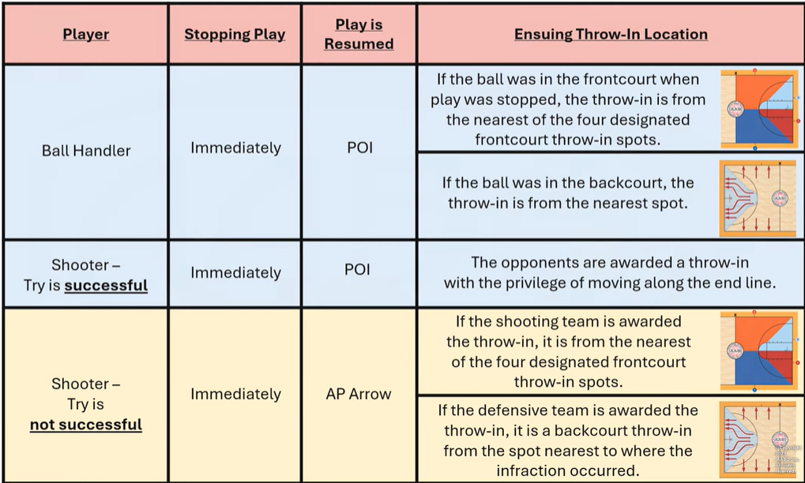
Flopping/Faking

Slide 33
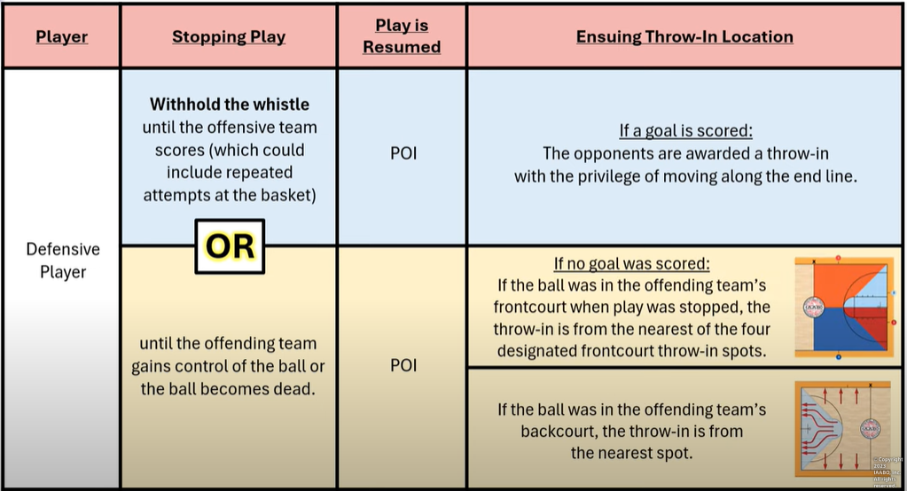
Flopping/Faking

